Slide 1
Take control of your mock !
Don’t worry, I have a
backup plan !
Notes:
Hello everyone ! Thank you for being here today.
It’s really a pleasure to talk about mock today with you ! The idea of this presentation came from a conversation with the AXA France front end community on testing methodology. Everyone wasn’t aware on how to manage local data and state without depending on the state of their web service.
In all our applications, we manipulate data very frequently. So, it’s essential, when you’re a front-end developper, to master your developer environment. We need to be able to develop anytime, anywhere
In this context, we will talk about mocks on the front end side with real demos, live coding, feedback, and tips !

Slide 2



Johnathan MEUNIER
Lead front @AXA France
@MonsieurNohj
John.meunier
Notes:
My name is Johnathan MEUNIER and I’m software engienner and lead front at AXA France, in the IARD Entreprise team. I’m based at Wasquehal, near Lille.
You can find me on Twitter or GitHub

Slide 3
Table of contents
Introduction
Mocks
01
02
MSW
Conclusion
03
04
My demo is broken !
What is it ? What’s now ? Demo
Setup, usage, tests, msw-ui, scenarios, advanced usage
Ressources, annexes, thanks
Notes:
As you understand, today we will talk about mocking our data on the front-end side.
There is a little summary of the following presentation, we will begin with a context presentation, then a presentation of what is a mock, a service worker, msw, and some useful tools & tips. At the end, you will retrieve some resources, a link to access a git repository with all the code from the live coding session, and a link to this presentation !

Slide 4
01
Introduction
My demo is broken !
Notes:
But first of all, I would like to tell you a story about a fabulous application that I develop !

Slide 5

Notes:
I develop an awesome app where I can search any character from the lord of the ring universe !

Slide 6

Notes:
I have a demo with Peter Jackson himself this morning

Slide 7
Notes:
But unfortunately, my API developer has deployed an update this night and since, everything seems broken, I can't access my API !

Slide 8

My demo seems broken
Notes:
I have a little demo to show you the current state of my app
Like you see, my fired developer wasn’t able to give me a proper way to handle this type of problem, so it wasn’t a priority for the first version.
Browser.js > setScenario("getPeopleError")

Slide 9
How can I prevent that ?
Internet issue
Prepare scenarios
API issue
Work without Internet, in a train, when my company proxy is not available
I don’t want to fill all my forms everytime or I want to improve the resilience of my app
My API is down or has changed
Notes:
Now that you have the context,
How can I prevent this type of problem ?
I want to be able to work without internet, in a train, without my enterprise proxy, when my API are down, or in any case that match with your needs.
I also want to control few main scenarios about my application.

Slide 10
02
Mocks
What is it ? What’s now ? Demo
Notes:
Mocks can save you, and do more !

Slide 11
What is a mock ?
Simulation of what would happen in a normal state
Not request directly the API
Simplify response
Have to be static (most of the time)
Notes:
First of all, what is a mock ?
A mock is a simulation of what would happen in a normal state, without a mock.
When you mock, the main idea is to not directly request the service but to work with a simplify response.
The response is simplify compared to what the service might return. Most of the time, it’s a static json file, deserved at the good time.

Slide 12
Pros & Cons
Pros
Cons
Work offline
Simulate your local dev with different scenarios
Stable environment, whatever the state of your service
A mock is almost instantaneous …
… but the real behavior of your application can be distorded
Your local data have to be up to date permanently with the real API (path, values, schema, etc)
Notes:
A mock solve all the previously mentionned problems:
It gives you the possibility to work offline
You can simulate any state of your application, some of them can be hard to handle without mocking them. Errors state for example.
You will be sure that you can always call your service and have a response, regardless of his condition
You won’t be impacted by the response time of your web service. It’s a comfort when you develop
But
You won’t have the same performance than your final product, that can impact the feeling of your app, and also the testing process
And the model of your mocked data have to be strictly the same as what the web service can deserve, Typescript can help you !

Slide 13
Current solution
Package like json-server can create a simple rest API which will serve static json file (or complex in some cases)
Powerful, this solution will redirect all the calls to a local webserver …
… but you need to launch a specific webserver in addition to your application
in your application, you will have specific code to manage the switch between this local server and the real API
Notes:
The are already known solutions for mocking.
Package like json-server help you create a simple rest API which serve static json file. This solution is near the production code but you will have specific code to specify that in local you will target your local rest api, and in production, the real web service. That can complexy your codebase

Slide 14
Current solution
Simplier, you can create static json file with your component and use this file.
Useful to initiate a development but impossible to use this code in production
Really far from the real behavior of your application
Notes:
An other solution is to create flat json file that you import in your component as any file. It’s a good solution because it’s really simple and fast to setup but it’s really far to the real behavior of the application

Slide 15
Demo of my working application
Notes:
MONTRER L’APP COMME ELLE EST CENSE FONCTIONNER
Browser.js > setScenario("getPeople")

Slide 16
03
Mock Service Worker
Setup, usage, tests, msw-ui, scenarios, advanced usage
Notes:
MSW will provide the benefits of the mock system, with the best conditions and transparency worflow.

Slide 17
MSW is a service worker
A proxy between a web app and your browser
Sandboxed
Lower level API
Web app
Service workers
(msw)
Browser
Notes:
Like you hear in the name Mock service worker, MSW is just the union of any mock system with a service worker.
But, before starting, what is a service worker ?
Service workers act as proxy servers that sit between web applications, the browser, and the network (when available).
They are intended, among other things, to enable the creation of effective offline experiences, intercept network requests and take appropriate action based on whether the network is available, and update assets residing on the server.
This definition is the part of the one provided on the Mozilla Developer Network.
And that seems to match our requirements. »Creation of offline experience, whether the network is avaiable »
They will also allow access to low level API, often not available in your browser without a worker.

Slide 18
Why MSW is the best solution ?
MSW will intercept some requests of the network layer of your browser
Totally transparent during the development phase
Nothing to do in the functionnal code, in your compoments !
Every is centralized in a specific part of your codebase
Notes:
As you understand, MSW will intercept some request, in a transparent way.
MSW, after a simple configuration, will work with a set of request handler and request resolver to intercept a request, and return a specific response.

Slide 19
Front setup
Notes:
DEMO SETUP FRONT A PREPARER
build: ajout de msw côté client · johnmeunier/dojo-msw@a6111d3 (github.com)

Slide 20
Request handler
import { rest } from 'msw’;
http.[get|post|put|•••](url,callback)
get
post
put
patch
delete
options
Exact : https://api.backend.dev/users
Wildcard : users/*
Parameters : `https://api.backend.dev/users/:userId`
RegExp : /\/users\//
Notes:
To intercept a request, you will write a request handler.
A request handler is really simple to write, it’s composed of 4 things.
It always begins with the usage of the rest method, imported from the msw package
After that, you will declare which http verb will be intercept (main verbs are supported)
And the url that you want to intercept. As you see the URL can be provide by different way
Finally, a request handler wants a callback, called a request resolver, it’s in this piece of code that you will precise the status and the content of the response, among others things

Slide 21
Request resolver
When the request is caught, you have to return a response. The response have to be a valid Response from the fetch API. So you can retrieve the base Response from the fetch API or the HttpReponse provided by MSW. HttpReponse make it easier some features :
- return json, xml, formData, etc
- set status
- provide headers
- mocking errors
- …
Notes:
When the request is caught, you have to return a response.
It’s the role of the request resolver
The body of the response is the data passed to ctx.json.

Slide 22
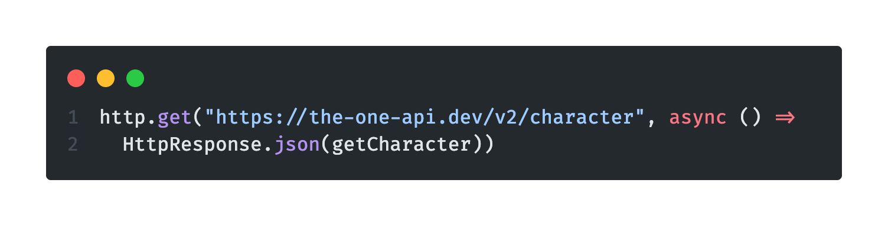
Request resolver
A complete but simple mock looks like this :
Notes:
There is an example of a very simple mock that intercept all the get request to https://my.api and always return a response with an http status 200 and a object with a res attribut that I a string hello as value.

Slide 23
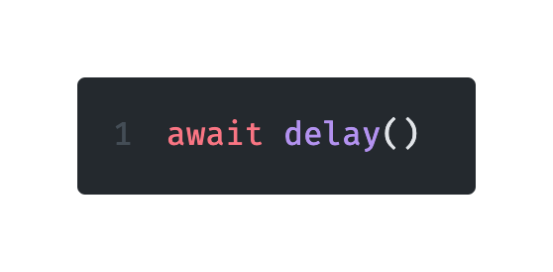
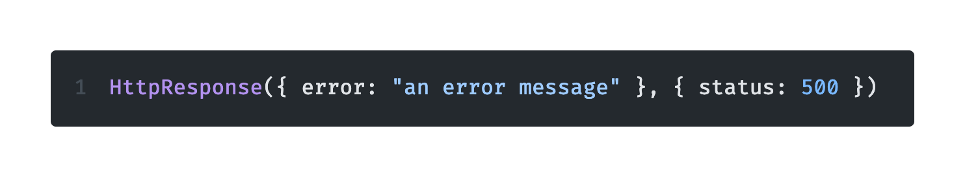
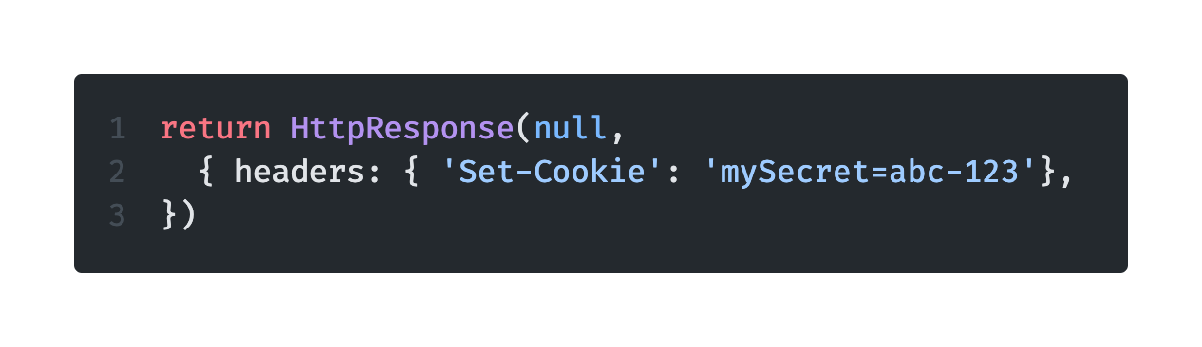
Request resolver
Add delay (always add delay !)
Change status
Provide headers
Notes:
In addition to the body of the response, the res method can receive additional useful information
You can add delay. It essential to reproduce as close as possible the behavior of the real application and be in the same condition as your user. It give you the possibility to see your loader if you have one. It also useful to have test that reproduce the asynchronous behavior of the loading of your components.
Forcing the status of the response is maybe the most useful feature of MSW. It’s often hard to simulate for each ressource of our webservices an error state. Here, you can force any status and develop specific behavior for your application : resilience pattern, error message, degraded mode
You can also set specific headers

Slide 24
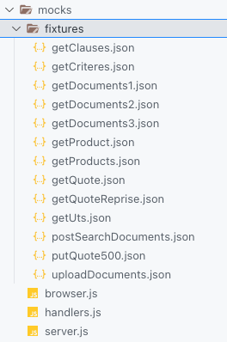
Request resolver
Organization
src/mocks/fixtures
[verbHTTP][ressource][metaInfo].json
Notes:
In addition to the body of the response, the res method can receive

Slide 25
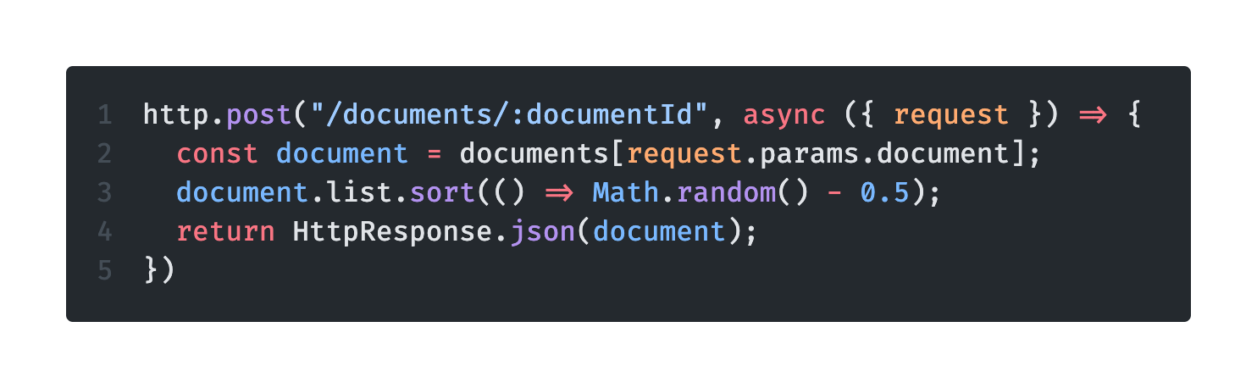
Request resolver
Complex response
Notes:
The response provided to your consumer is the return of the callback of your request handler
So, you do not have to immediatly return the res method
You can transform your data before send them
And you can obviously retrieve some information from your request, like your route params

Slide 26
Demo : fetch, simple mock, delay, status, headers, complex response
Notes:
Commit cd11f79f: feat(Risk): Ne pas accèder à la page Tarif si l'API génère une erreur - Repos (azure.com)
feat: fetch basique · johnmeunier/dojo-msw@eca6e3c (github.com)
build: mock getPeople1 · johnmeunier/dojo-msw@28e72b9 (github.com)
return (
<div className="App">
<h1>LOTR characters</h1>
{error ? (
<img src={sauron} alt="sauron eye" />
) : people.length > 0 ? (
<ul>
{people.map((person) => (
<li key={person._id}>
<Gender gender={person.gender} />
<a href={person.wikiUrl}>{person.name}</a>
</li>
))}
</ul>
) : (
<h2>Loading</h2>
)}
</div>
);

Slide 27
Test
Avoid mocking directly fetch, axios or your api consumption hook because you will create a dependance.
Mock your call throught MSW, regardless of how you interrogate it.
Notes:
It’s a bad practice to mock your library, package, or anything like that because you will short circuit the normal behavior of your app
It’s better to mock the data layer

Slide 28
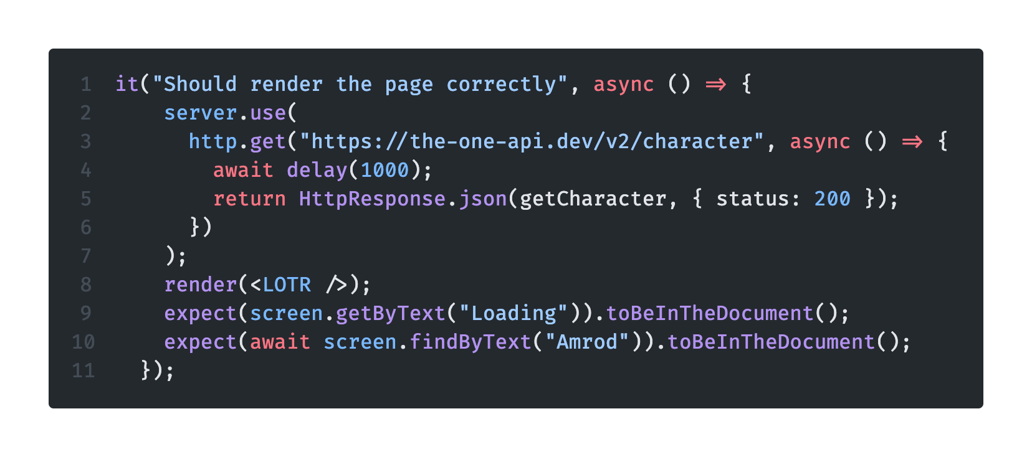
Specific mock in a test
Simple solution
Notes:
The process that I just showed you gives the possibility of directly use your local mock in your test.
It can be very good to has some tests that directly reflects your local and dev behavior
But sometimes, you need to give specific data to a test to test some specific behavior : errors, specific scenarios, etc
As you can see, you can call server.use and give similar implementation as your local mock but with specific callback
This mock will be apply only for a test file or event in some case, specificly for a test

Slide 29
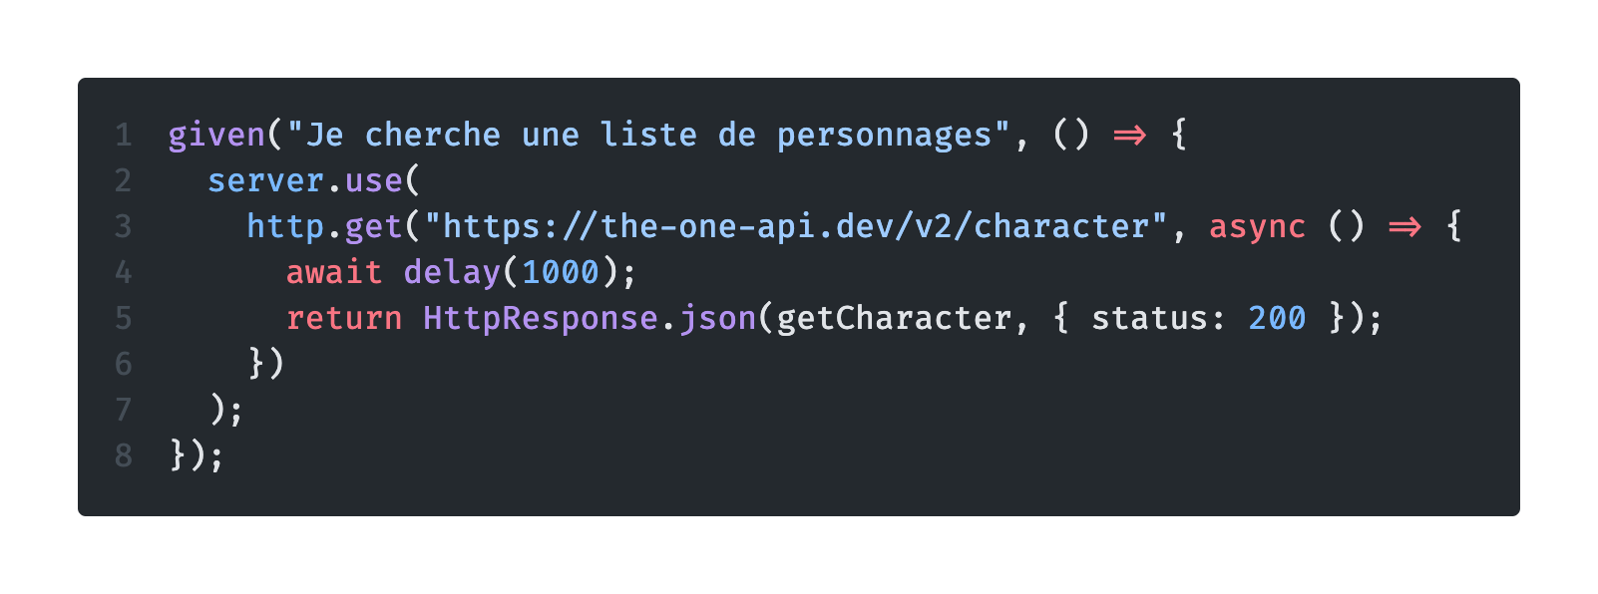
Specific mock in a test
With a gherkin feature file
Notes:
The best practice is to use your mock during integrated scenarios

Slide 30
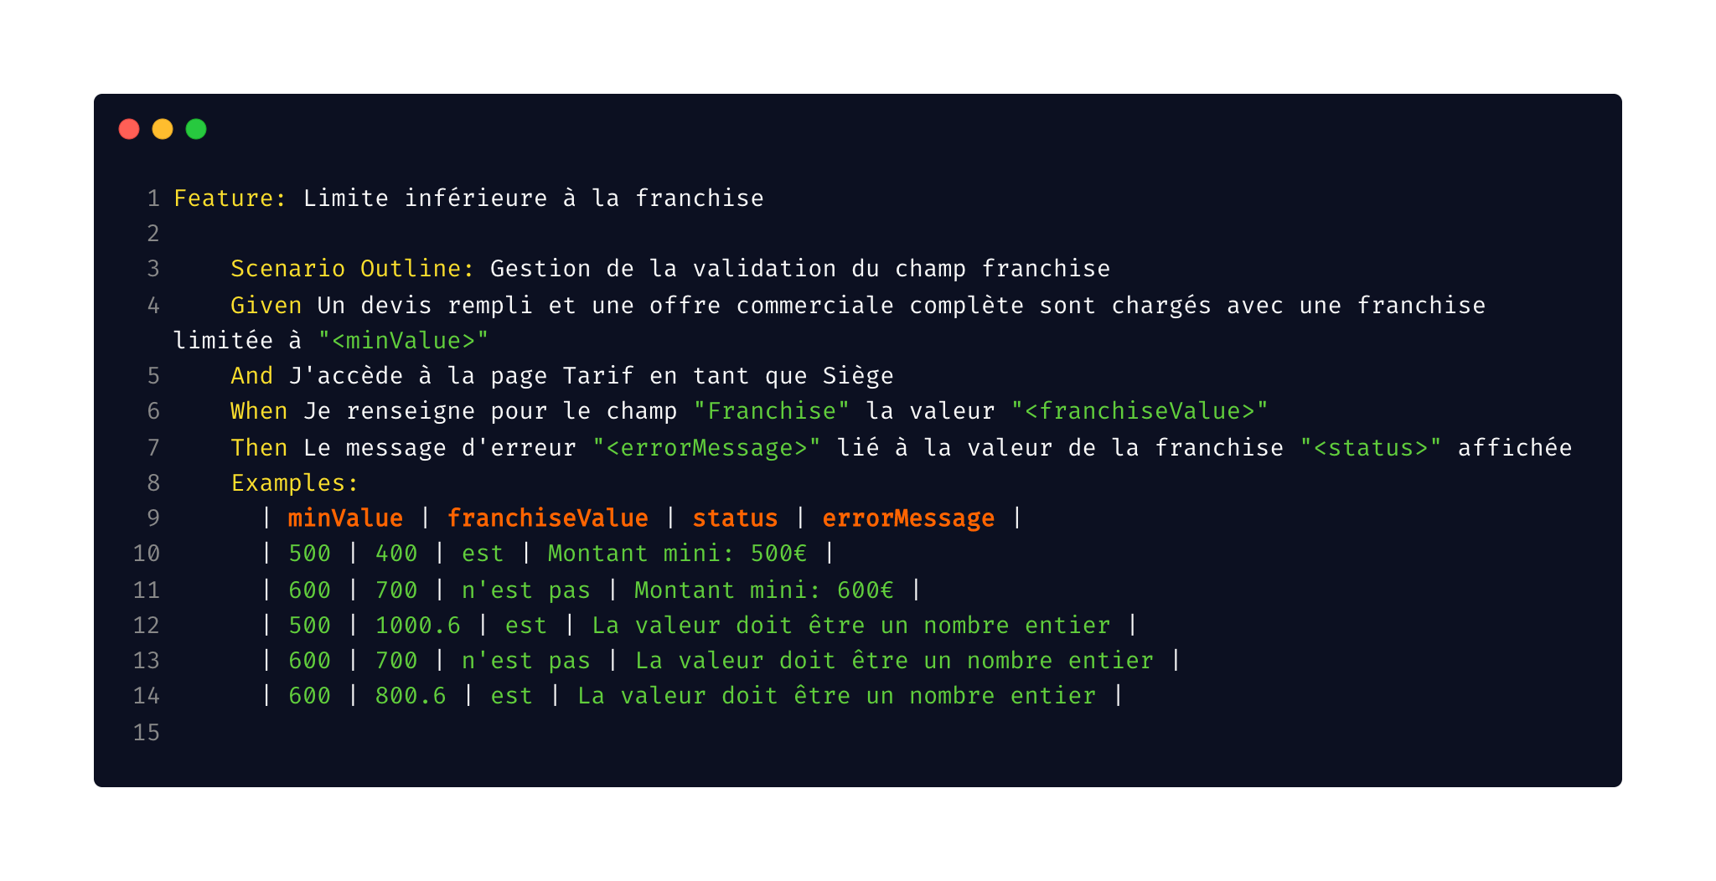
Specific mock in a test
Variable throught .feature
Notes:
And couple that with a feature file !
This file is in french but it’s not an important point.
The main concept here, is that you can use your .feature file directly to store the data used by your mock for your test
Here you can see a table of data with key as minValue, franchiseValue, status and errorMessage

Slide 31
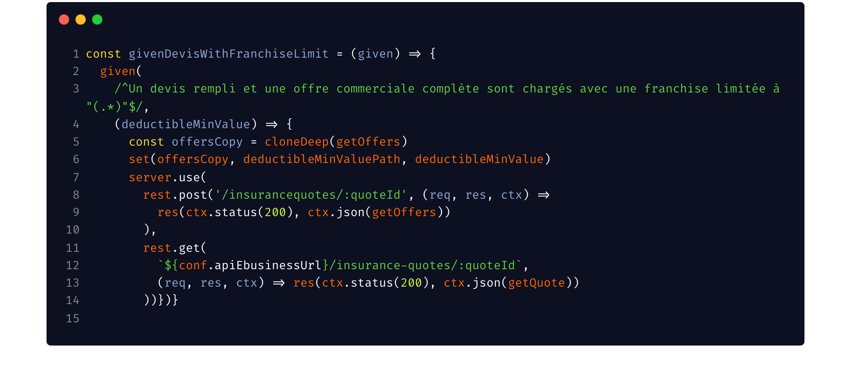
Specific mock in a test
Notes:
And in my step definition, I can use the data from my feature file to dynamically create my mock !
It’s really useful !

Slide 32
Demo MSW & Gherkin

Slide 33
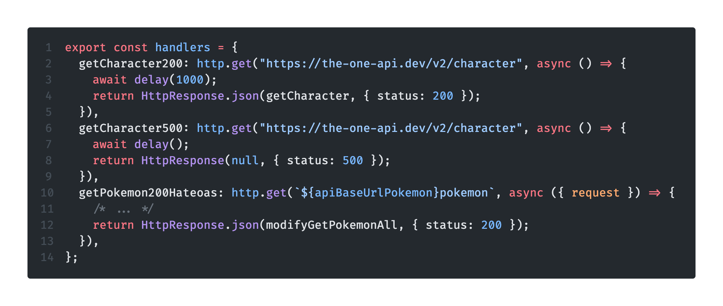
Name your scenarios !
Notes:
In most of cases, serving static files is enough
But sometimes, the service enriches the data sent
Don’t redevelop the service in your handler, keep it as simple as possible.
You can follow a simple rule : If you have this data in your request, so add this data in your answer.
Be careful not to fall into the trap to redevelop the targeted web services.

Slide 34
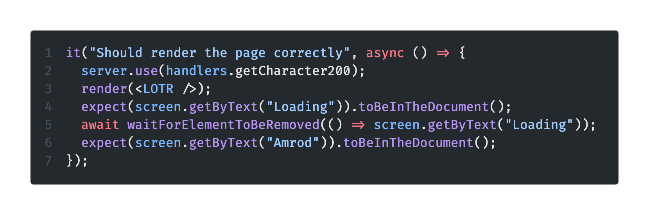
Name your scenarios
In a test
Notes:
The process that I just showed you gives the possibility of directly use your local mock in your test.
It can be very good to has some tests that directly reflects your local and dev behavior
But sometimes, you need to give specific data to a test to test some specific behavior : errors, specific scenarios, etc
As you can see, you can call server.use and give similar implementation as your local mock but with specific callback
This mock will be apply only for a test file or event in some case, specificly for a test

Slide 35
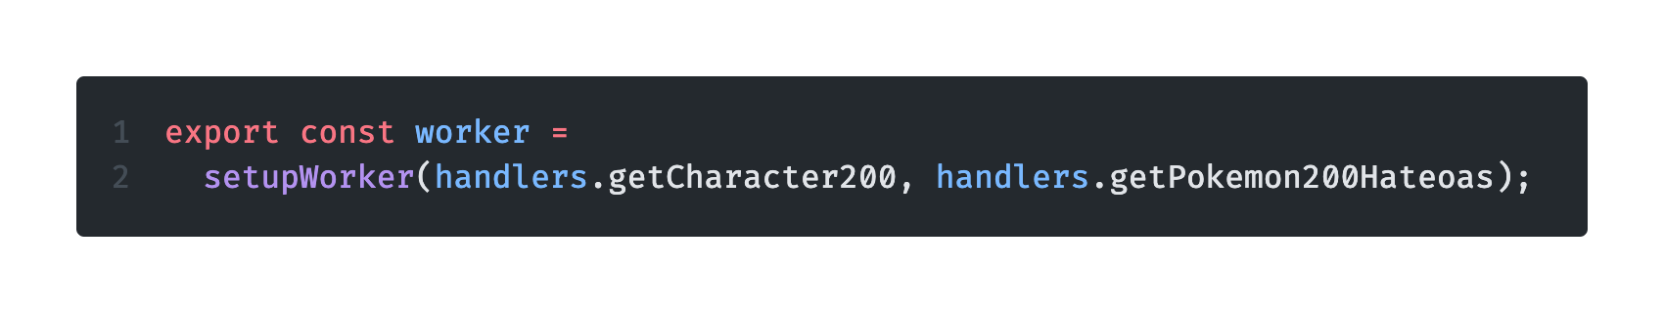
Name your scenarios !
Notes:
In most of cases, serving static files is enough
But sometimes, the service enriches the data sent
Don’t redevelop the service in your handler, keep it as simple as possible.
You can follow a simple rule : If you have this data in your request, so add this data in your answer.
Be careful not to fall into the trap to redevelop the targeted web services.

Slide 36
How far should we go in the mocks ?
In most of cases, serving static files is enough
But sometimes, the service enriches the data sent
Don’t redevelop the service in your handler, keep it as simple as possible. If you have this data in your request, so add this data in your answer.
Notes:
In most of cases, serving static files is enough
But sometimes, the service enriches the data sent
Don’t redevelop the service in your handler, keep it as simple as possible.
You can follow a simple rule : If you have this data in your request, so add this data in your answer.
Be careful not to fall into the trap to redevelop the targeted web services.

Slide 37
Typescript
Typescript can help you.
Your mocked data have the same model as your web service
Notes:
Typescript can really help you. Mock is manipulation of data. It’s useful to type your mock, specificly if you can extract definition file from your json schema or you swagger for example.
With this, it’s simplier to ensure that your mock have the same model as your web service

Slide 38
Develop the consumer before the service
In some cases, in can be very useful to develop the service consumer before the service :
You have a back for front that transform your data
The back-end team is late on the project
…
Your contracts between your services and your consumers can’t change
Notes:
One of my favorite possibility when I’m using mock in a project is to be able to develop a feature before the service is done. Indeed, in some case, especially in big team with big project, you won’t develop the back-end and the front-end.
the constraint is to be certain that the contracts between your services and your consumers won’t change

Slide 39
Cohabitation with authentication
Only one service worker per scope is allowed
Sometimes, your authentification will work with a service worker (hello auth-worker and the latest version of react-oidc)
During the local dev, use the MSW and mock the auth
When you deploy, use the auth and disable mock

Slide 40
04
Conclusion
Ressources, annexes, thanks

Slide 41
MSW-UI
Delay
Typescript
Request resolver
Service worker
Request handler
MSW
Enrichments
In advance
Scenarios
Test
Fixtures
Resilience
Notes:
During this presentation, we have talked about several topics.
You will retrieve this slides, the demo, and a complete exercice on this github repo

Slide 42

Thanks
Do you have any questions?
https://bit.ly/mock-msw
Johnathan MEUNIER
@MonsieurNohj
Notes:
Thank you everyone for being such a good audience.
Do you have any questions ?

Slide 43
Resources
Slide template from Slidesgo
Repo github : johnmeunier/dojo-msw (github.com)
MSW : MSW – Seamless API mocking library for browser and Node | Mock Service Worker (mswjs.io)
MSW-UI : fvanwijk/msw-ui: UI for Mock Service Worker to set mock scenarios on runtime (github.com)
AXA France GuilDev on Github (auth-worker, react-oidc, etc)

